Slide 1
Azure AI Search

Slide 2
David Giard
Microsoft Partner Solution Architect
davidgiard.com
aka.ms/gcast
technologyandfreinds.com

Slide 3
Features
Indexing
Vector and Hybrid Search
AI Enrichment and Knowledge Mining
Query and User Experience
Security
Portal Features
Programmability
Notes:
Feature descriptions - Azure AI Search | Microsoft Learn

Slide 4
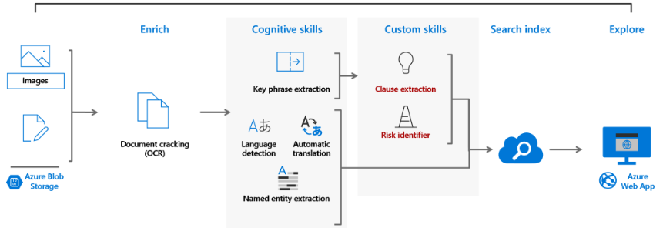
Pipeline
Source: Study Guide for Microsoft Azure AI-100: Designing and Implementing an Azure AI Solution | by Shivam Sharma
Notes:
Source: Study Guide for Microsoft Azure AI-100: Designing and Implementing an Azure AI Solution | by Shivam Sharma | Applied Deep Learning | Medium

Slide 5
Indexing
Data sources
Hierarchical and nested data structures
Linguistic analysis

Slide 6
Vector and Hybrid Search
Vector indexing
Vector queries
Vector search algorithms
Vector filters
Hybrid information retrieval

Slide 7
AI Enrichment and Knowledge Mining
AI processing during indexing
Storing enriched content for analysis and consumption in non-search scenarios
Cached enrichments

Slide 8
Query and User Experience
Free-form text search
Relevance
Geospatial search
Filters and facets
User experience

Slide 9
Security
Data encryption
Endpoint protection
Inbound access

Slide 10
Portal Features
Tools for prototyping and inspection
Monitoring and diagnostics

Slide 11
Programmability
REST
Azure SDKs for:
.NET
Java
Python
JavaScript/TypeScript

Slide 12
Steps
Add documents to data store
Create Azure Search Service
Add Data Source
Create and run Indexer
Query data and metadata in documents

Slide 13
Demo

Slide 14
Thank You!

